Slide 1

Group 3.5 Project: UofCMingle

Slide 2
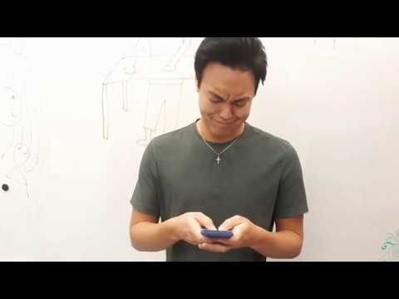
Video Presentation

Slide 3
Storyboard

Slide 4
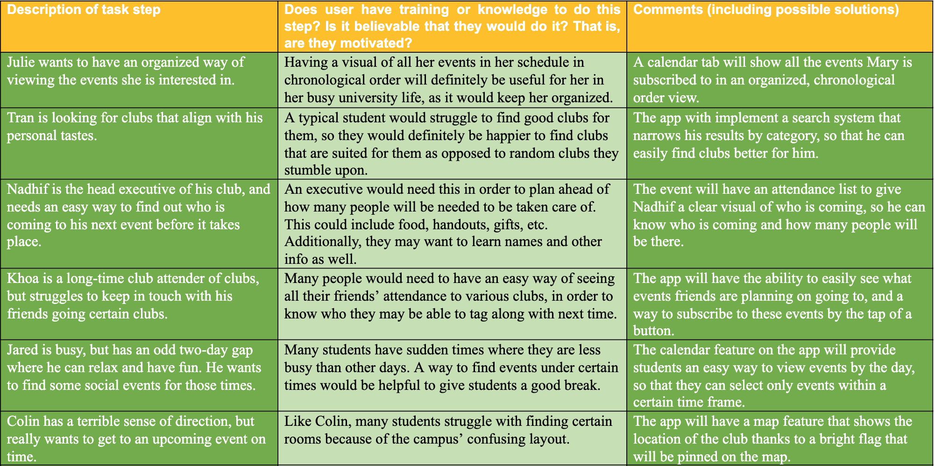
Task-Centered Walkthrough
Ultimately we didn’t see any need to revise the tasks we created in stage 2; we were generally happy with the look and feel of the prototype

Slide 5
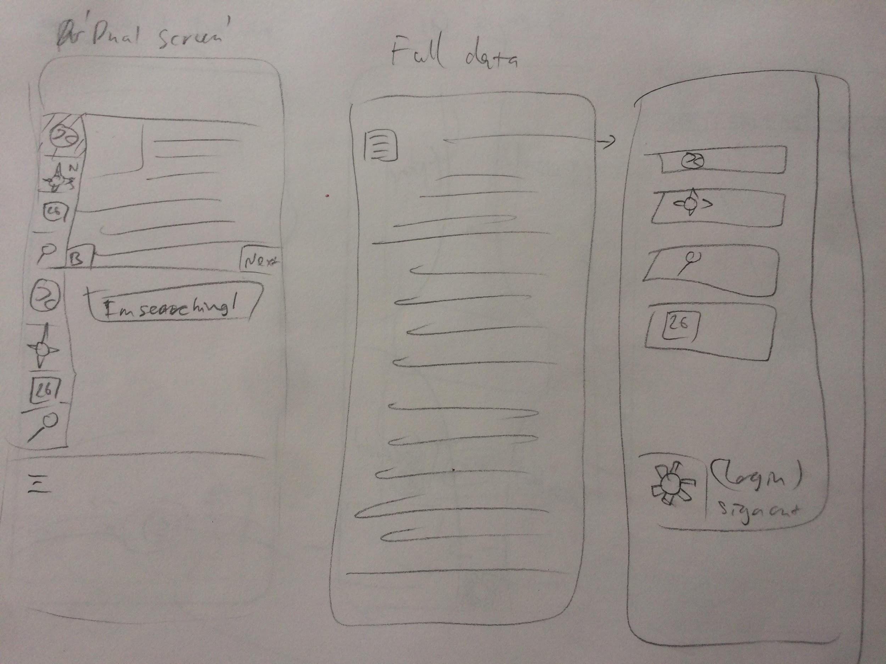
Sketches
These sketches concerned about how to display the information for the app, should it be through various tabs? How much information should be displayed for each tab. Should there a set of tabs for each event (A search, map, and calendar tab)?

Slide 6
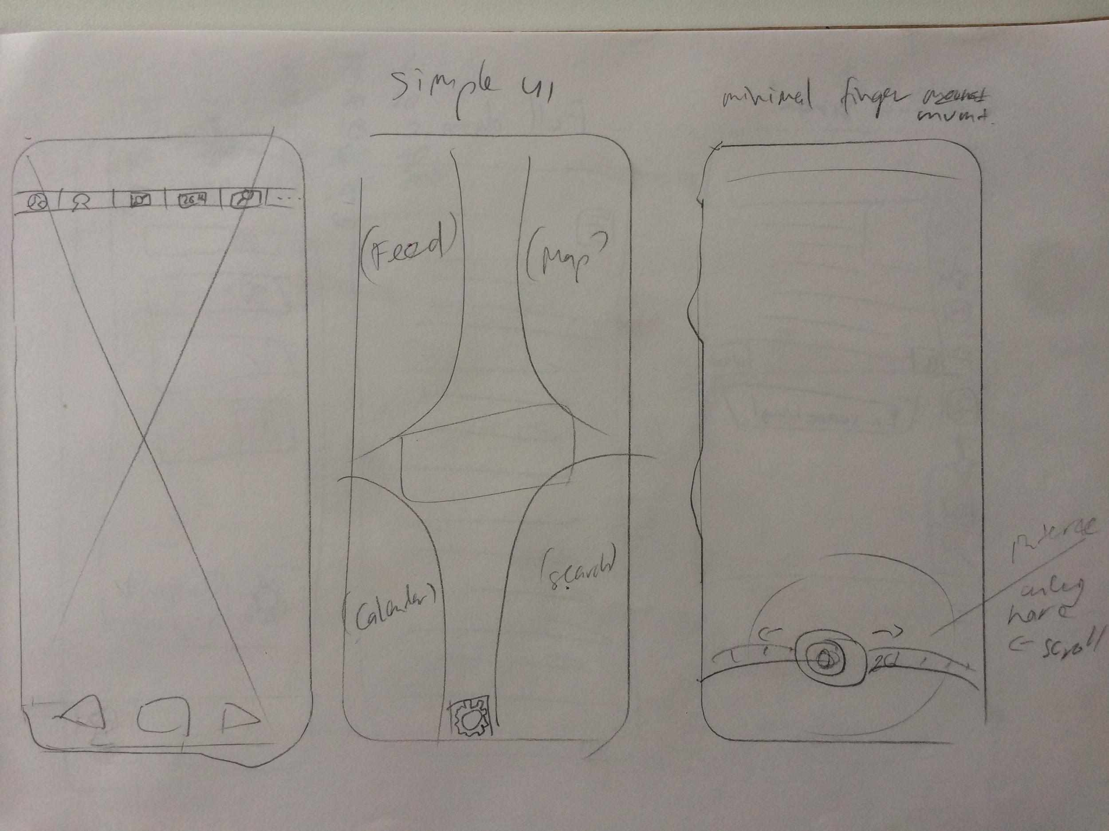
Sketches
The three sketches here were designed around how to navigate around the program, with the main focus of minimal movement of the user’s hand (or primary their thumb in these cases).

Slide 7
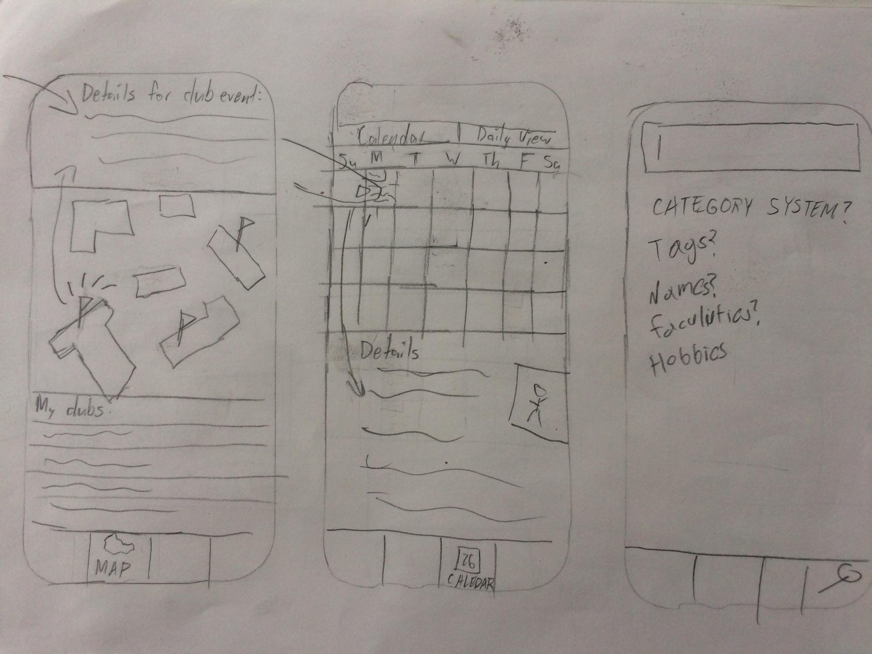
Sketches
These sketches was centered around a map system that would lead to either the calendar or searching menu of the app in order to mark the locations of the events the user would want to go to.
The map would also have various tabs for information regarding each event the user has signed up for.

Slide 8
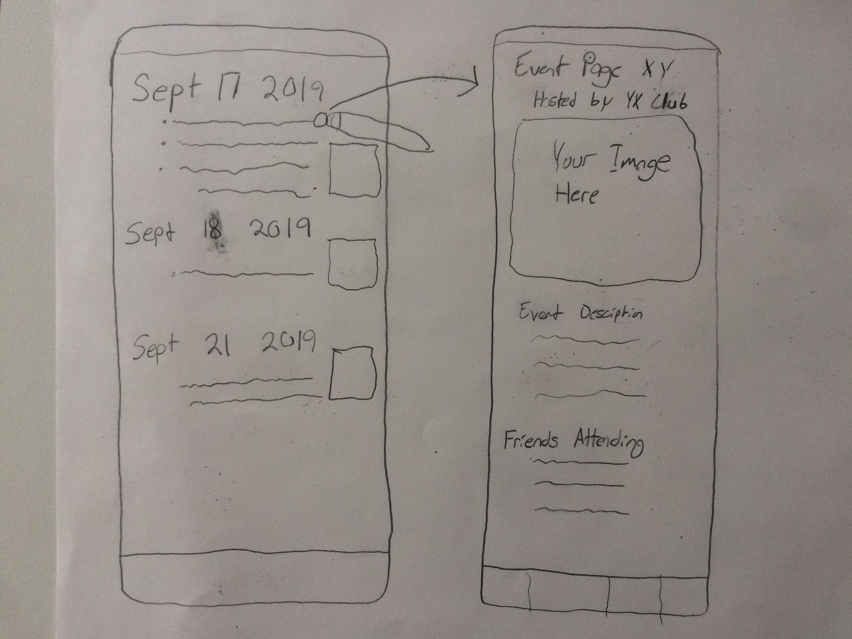
Sketches
Idea for a daily/weekly view that provides more details (including images) than the calendar view of events. Tapping on a given event would lead to the event’s page, with information like friends attending (assuming a friend system was implemented).

Slide 9
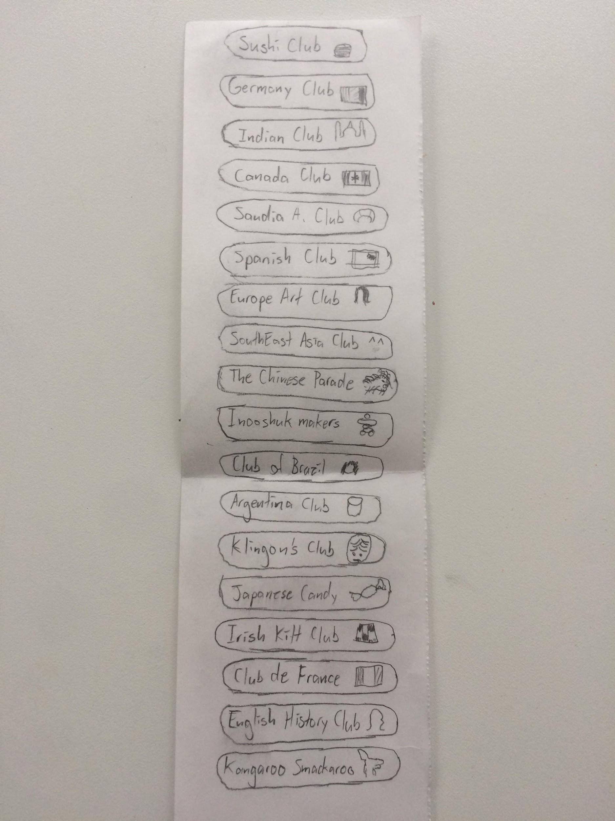
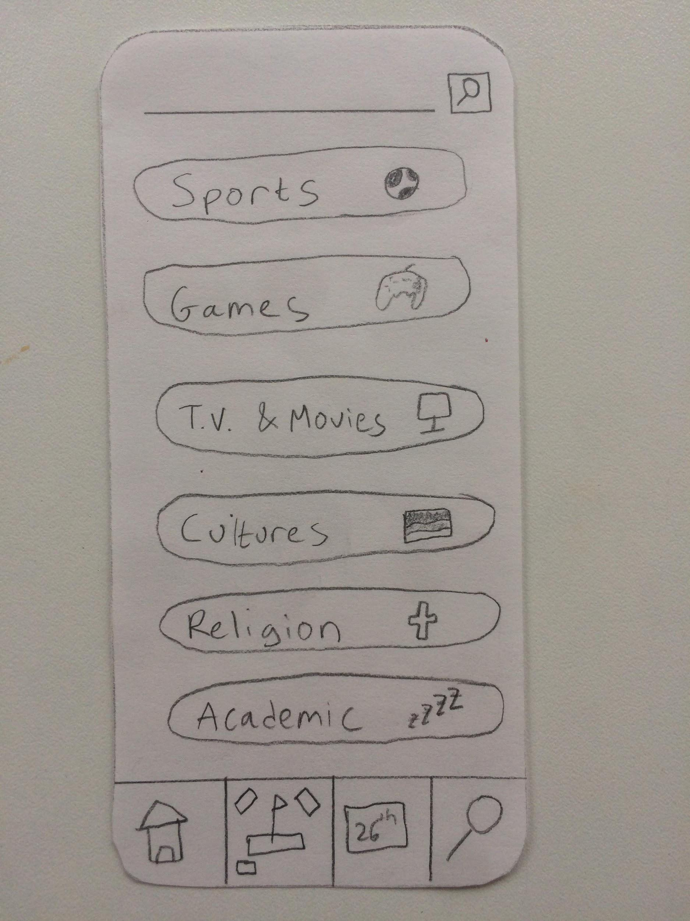
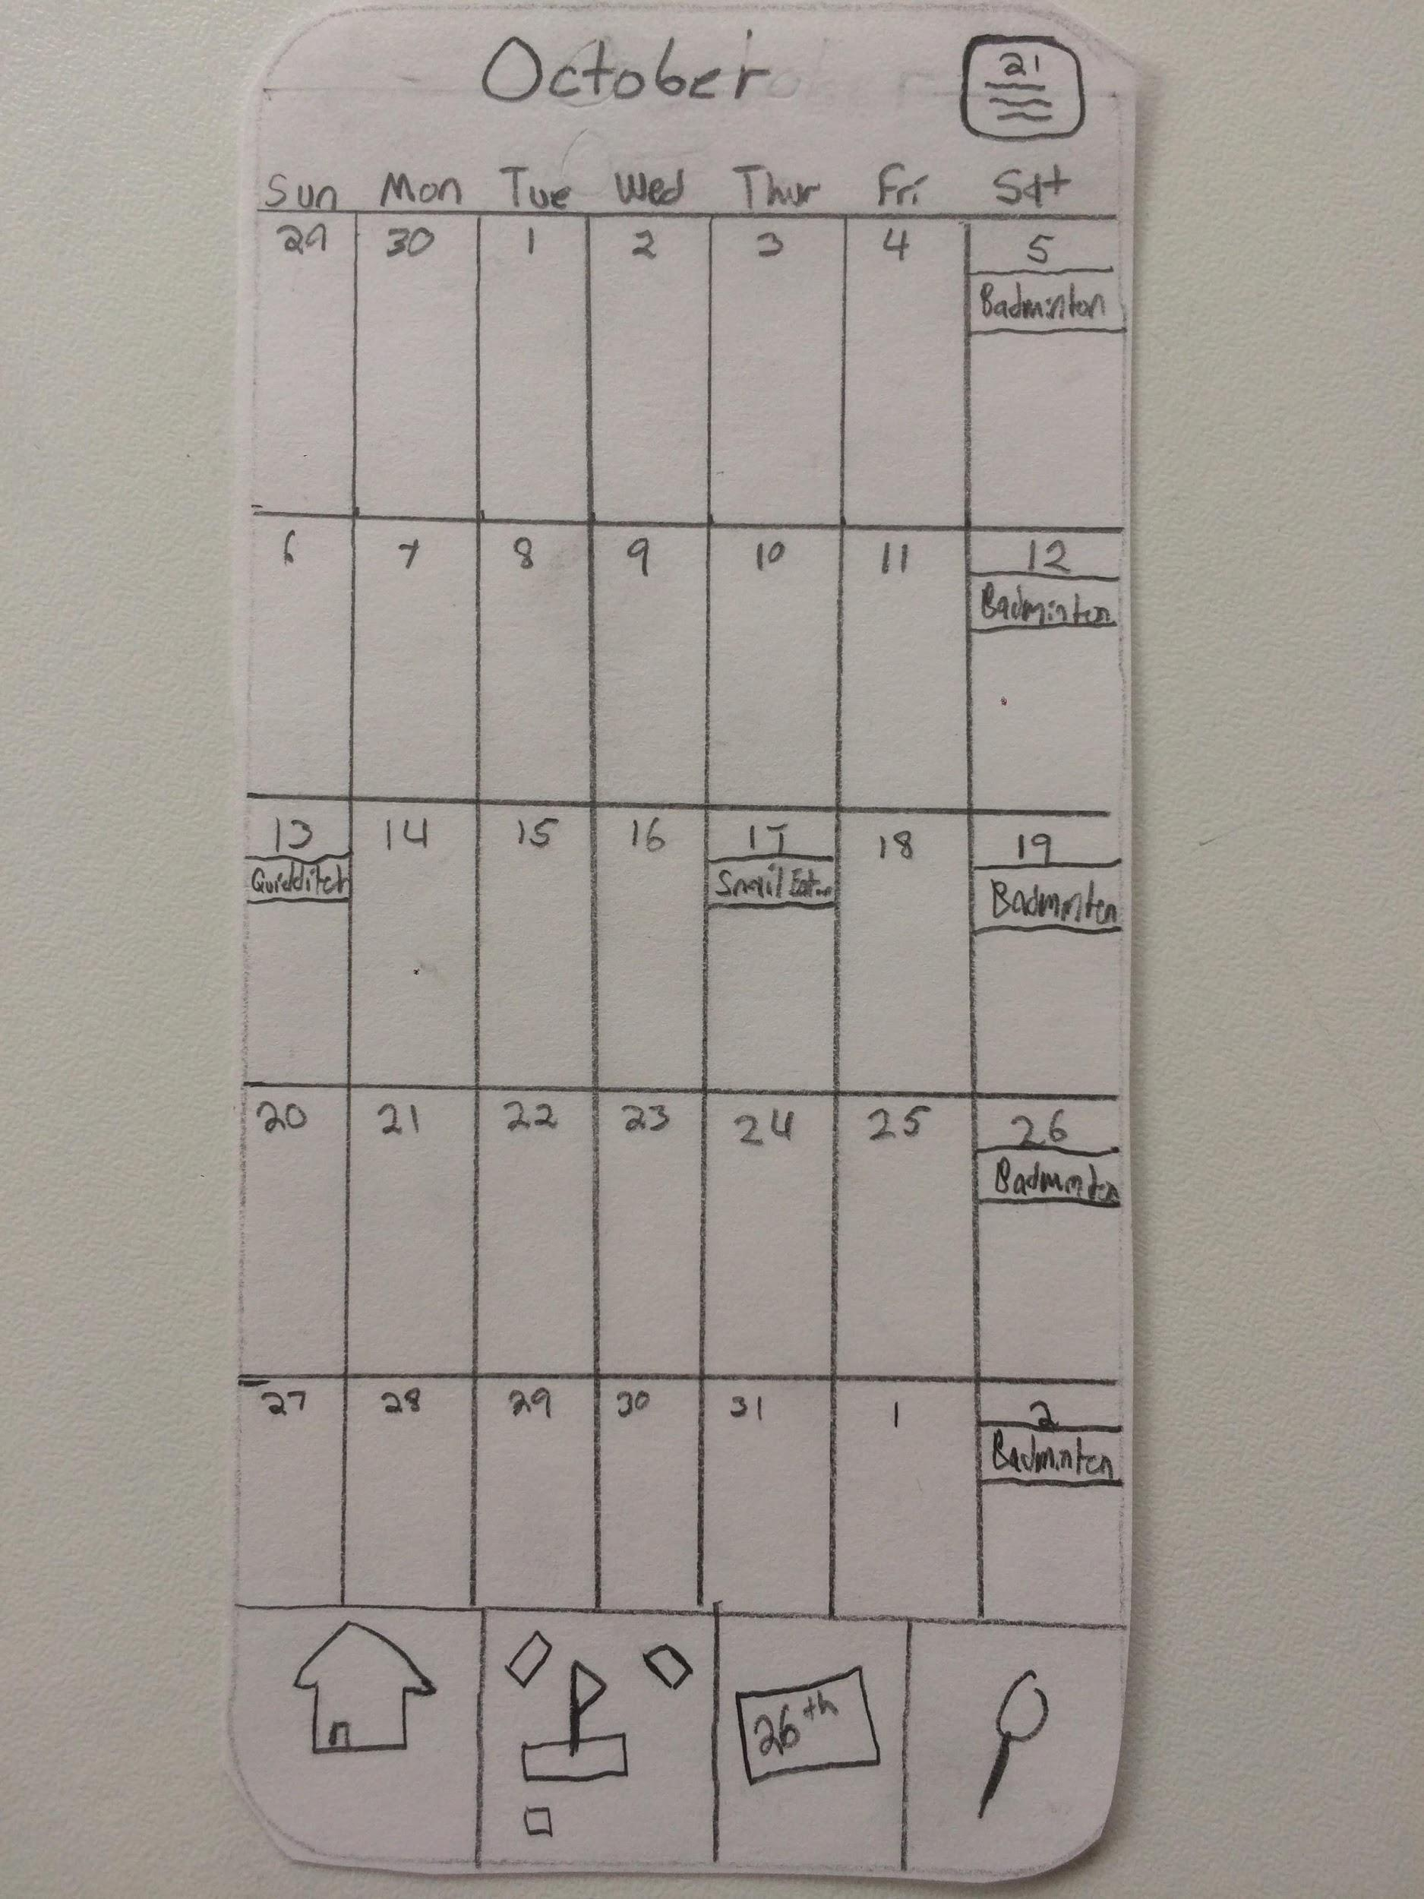
Prototypes Used in Video

Slide 10
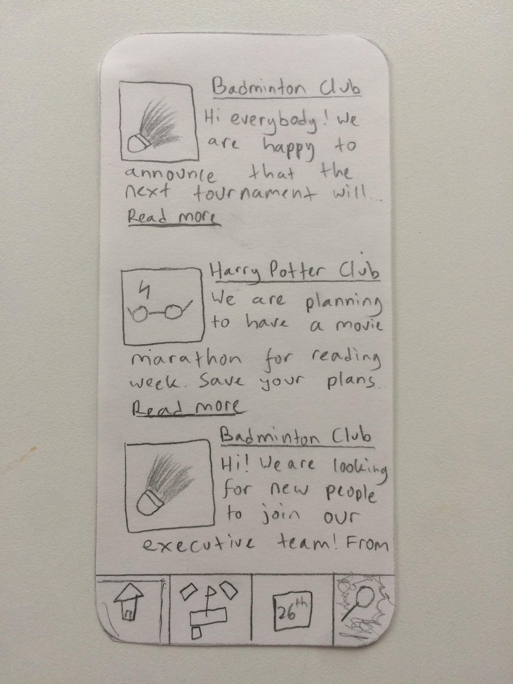
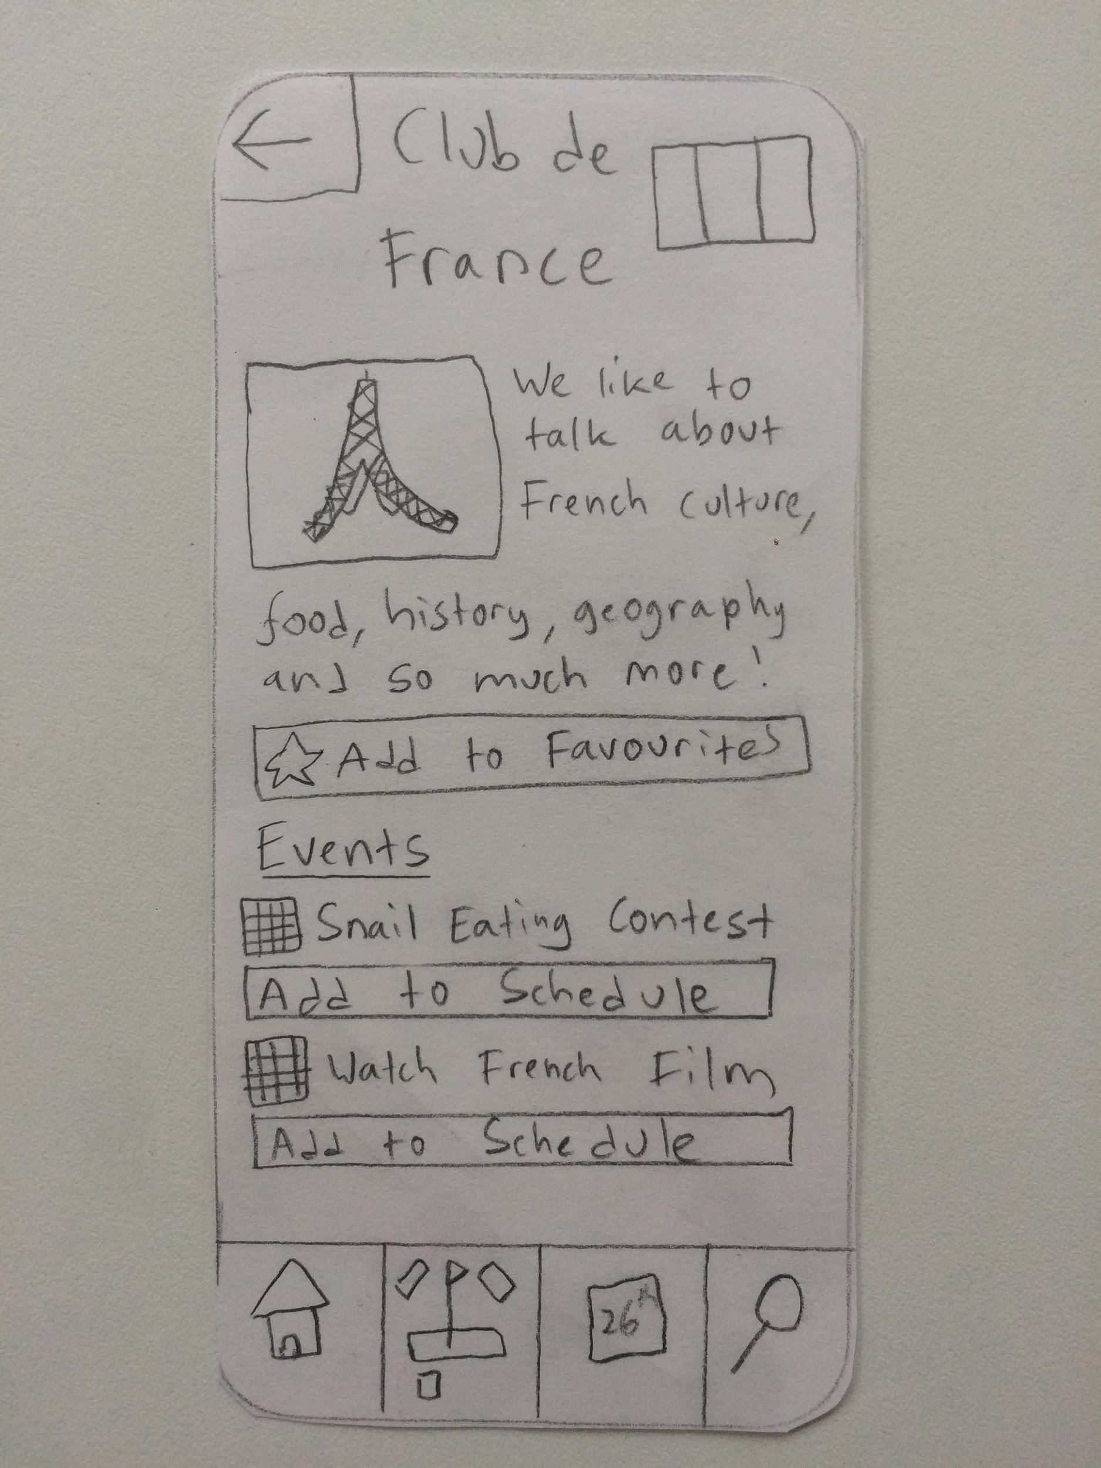
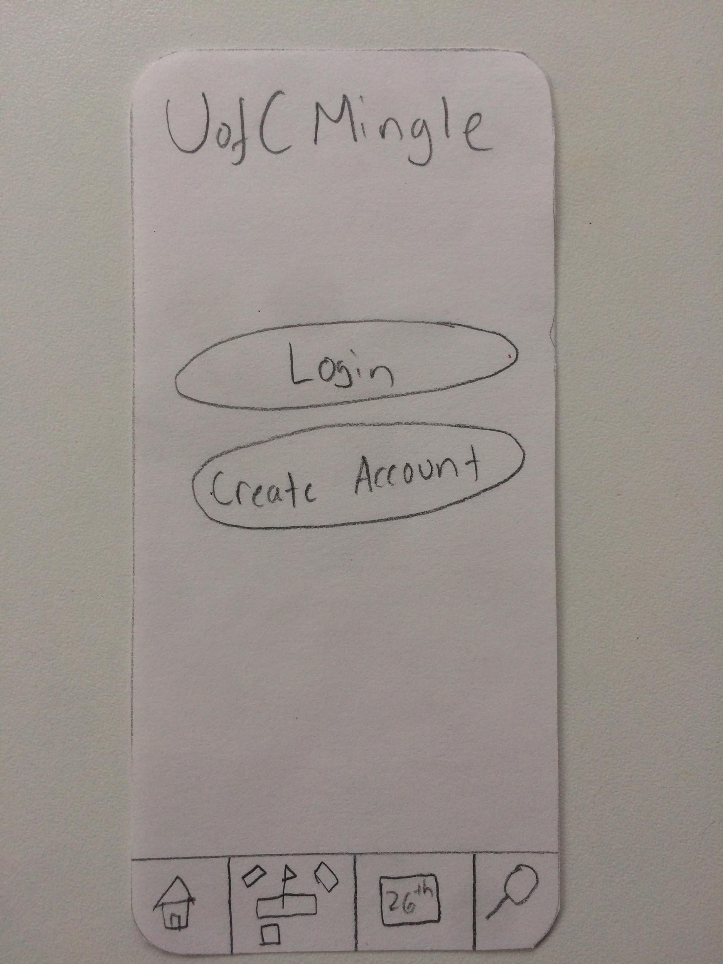
Prototypes Used in Video

Slide 11
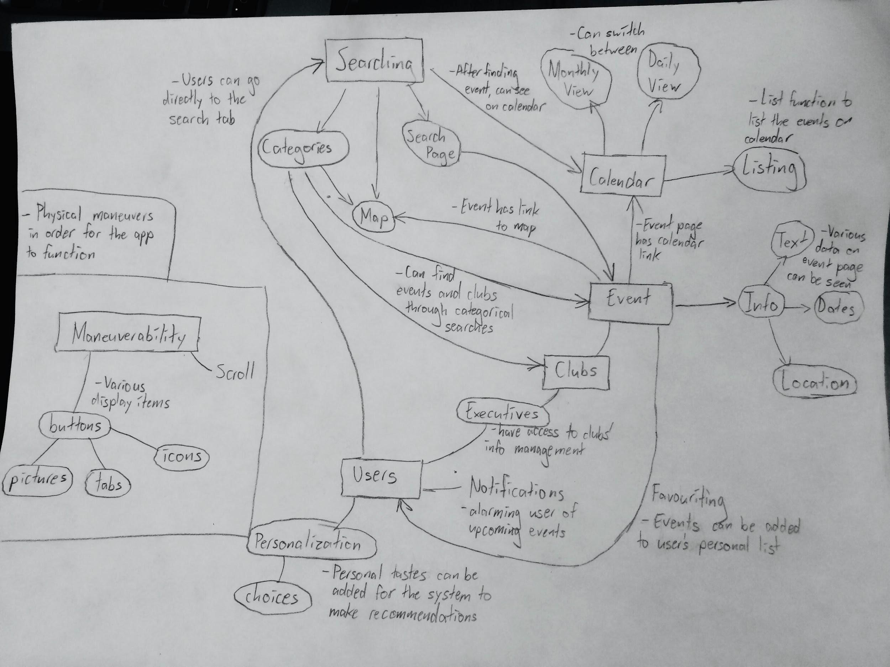
Affinity
Diagram

Slide 12
Affinity Groups
Maneuverability
Searching
Users

Slide 13
Maneuverability
We use a range of buttons that will be images, icons, tabs. The icons and images provide a more fun and visual interface for the user. Tabs are the universal interface across the apps so that you can always get to the main features with one click.
We will also use scrolling to demonstrate more information on one page and it will be easy to find the needed information as they will be placed in order, e.g. by date.

Slide 14
Searching
Our main way of searching is through categorisation. And text searching. Users can choose categories to filter out their searches. They can search by text to find a specific club. These categories will then affect the visual map and calendar which users can use to find information.
The calendar can be further filtered into daily or monthly information. The map will pop up flags where events are held to provide more visual information for the users

Slide 15
Users
Users will be able to add information about their interests in the clubs and events. They do so by selecting the clubs they like and also categories they are interested in. They can highlight specific events that they are interested in which will cause them to get notified as a reminder.
Users can connect with other users to see what events and clubs that others’ are interested in or going to.

Slide 16
Reflection
During this stage we began with brainstorming and sketching various ideas we had for the design of our app. This process helped us to nail down certain aspects that should be central to our design, and further refine them into a working storyboard and video prototype that gives us a clearer idea of how we can move forward.
We weren’t entirely clear about how to start with affinity diagramming, and if we were to do it again we might ask more questions earlier to make sure we were heading in the right direction.

